Slide 1
Integration for Google Services
ALL NEW
Notes:
Welcome to What’s New in OnBase 14 for the all new “Integration for Google Services”.
This is our first step, but we are committed to private and public cloud application integrations...google, salesforce, office 365, Microsoft office web app server…and I hope you’re as excited about it as I am!

Slide 2
Google Services Integration
Unity Client in 14
Import from Google Drive
Google\Office Document Viewer
Checkout to Drive (for Edit)
Send to Mail via Gmail
Notes:
Play in Google world!
The Google Services Integration will allow OnBase users at company sites using Google Apps for Business to leverage their Google services from OnBase clients. This includes downloading files from Drive into OnBase, viewing Google and Office files via a Google document Viewer, checking documents out to Drive for editing using Google Docs, and sending external mail with Gmail. The OnBase 14 release will focus on the Unity Client.
Features to be included
Import from Drive allows importing documents from Google Drive to OnBase.
New viewer for OLE, leveraging Google Drive viewer
Check-Out to Drive allows for editing “Office” documents using Google Docs and saving the revisions back to OnBase...Google Docs embedded in Unity….view / read-only in Unity…editor is the CLOUD
Send-To-Email allows sending attachments via Gmail
Co-Authoring two people editing at same time!!

Slide 3
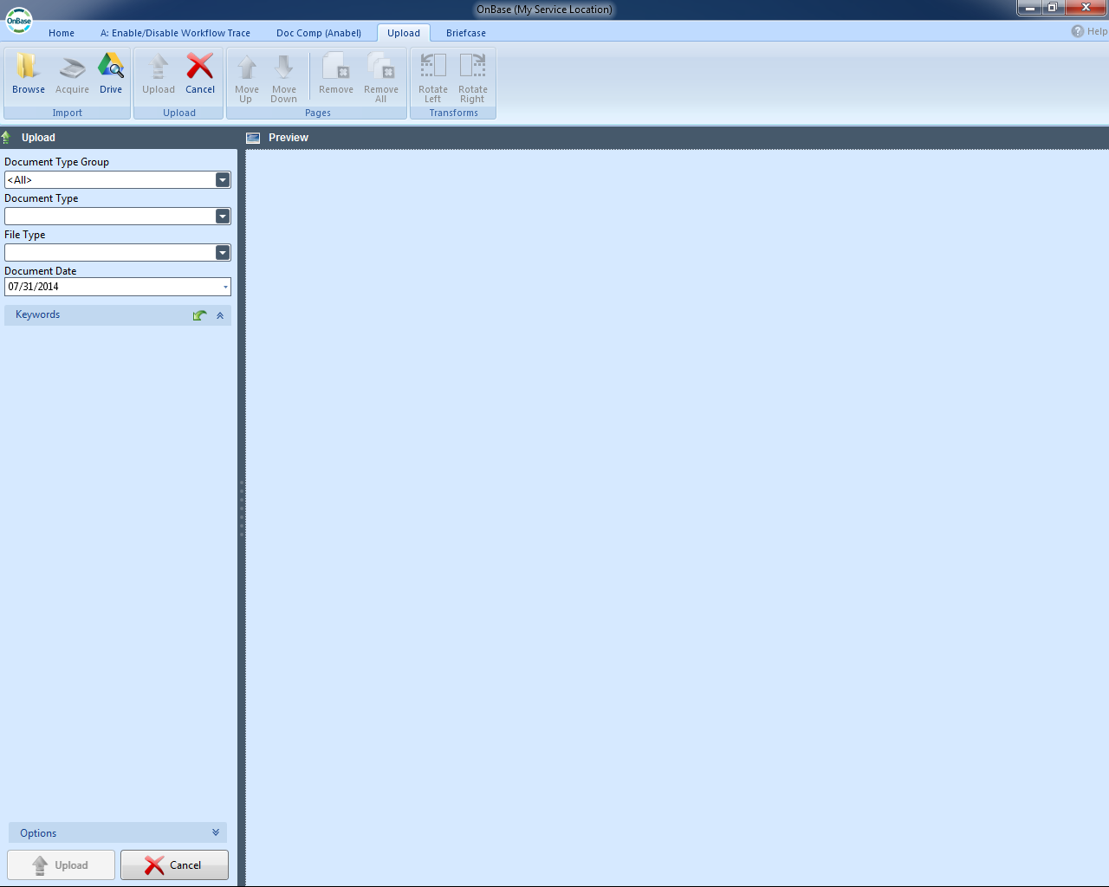
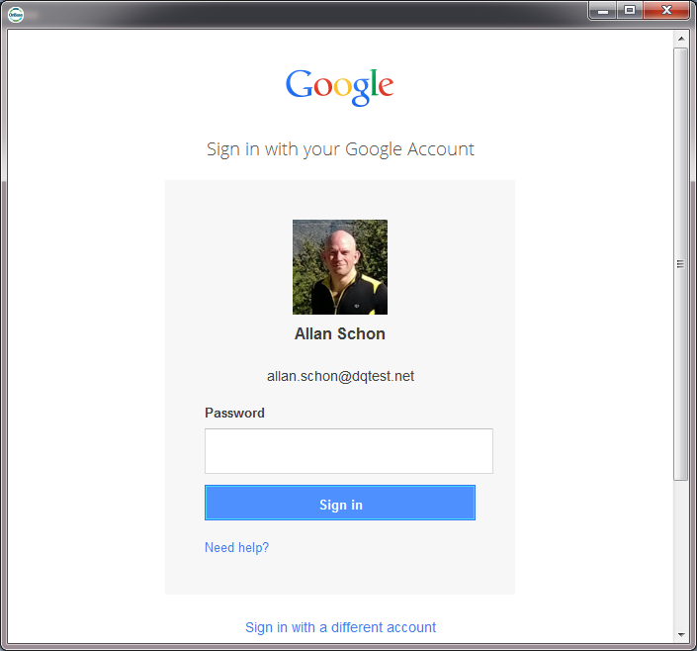
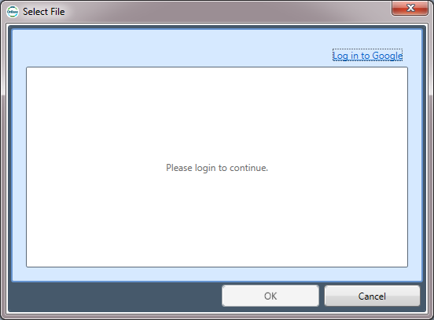
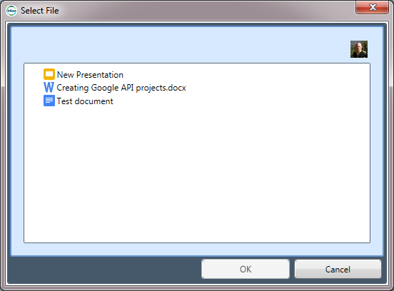
1. Import from Google Drive
Upload files from Drive into OnBase
Notes:
Import from Google Drive ***Google Services Upload***
Acquire/Upload into OnBase from Drive...have to login to Drive account (we don't store Google credentials, we use O auth...cloud standard for authentication)...select Document, then Upload.
Share file with another user from Drive, will appear in list.

Slide 4
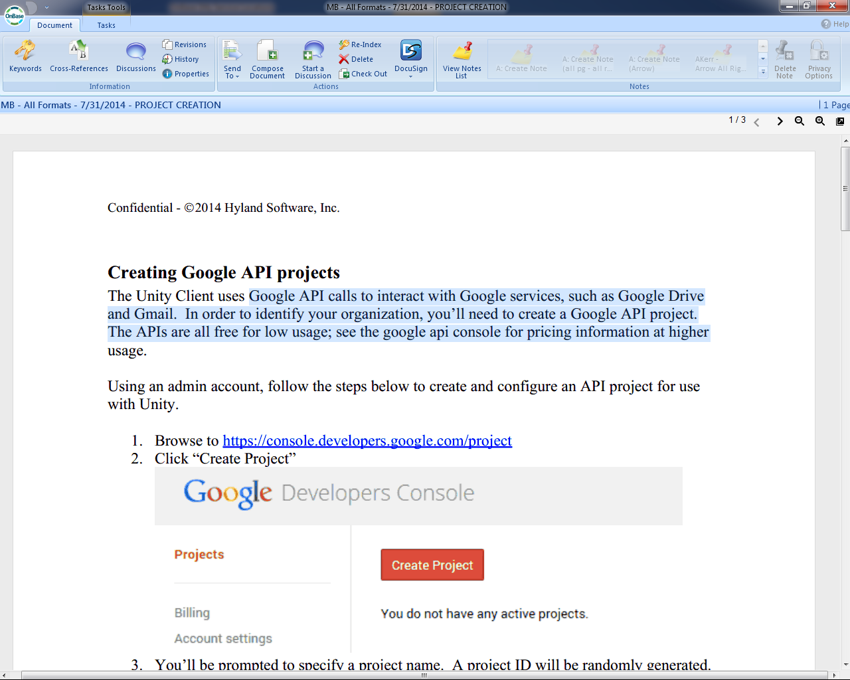
2. Google Document Viewer
View documents without Office
Notes:
Google Document Viewer
Google users probably don't have Office / WORD....we created a Google Drive Viewer...read only view of Excel, Word, PowerPoint, and Google formats for word processing documents...HTML and CSS...
Primarily supports Office file format...images...PDFs...but we only use to replace our OLE viewer
READ ONLY

Slide 5
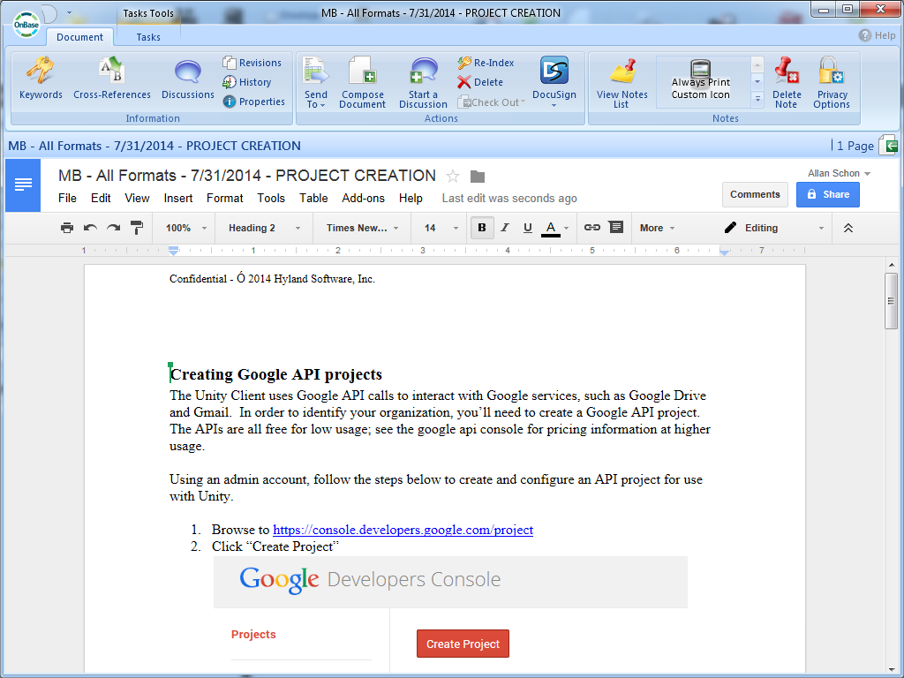
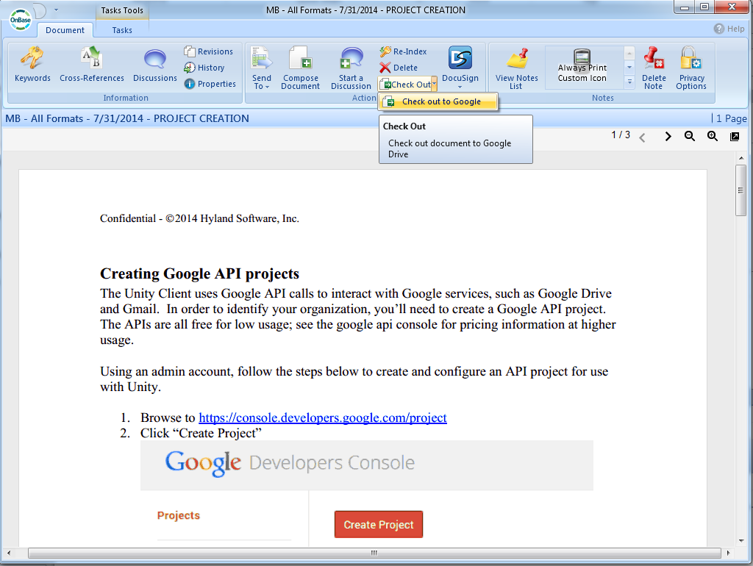
3. Checkout to Drive (for Edit)
Checkout to Drive for Edit, Check-in as Revision
Notes:
Check Out to Drive (for Edit) ***Checkout to Google***
creates copy...co-authoring...uses Persistent Document Checkout.
Send it up there and remember where it is...prevents modification on copy still in OnBase...Word, Excel, PPT, ODT (open document text)
Check-in as Revision (old revision still exists) or Save as a NEW document

Slide 6
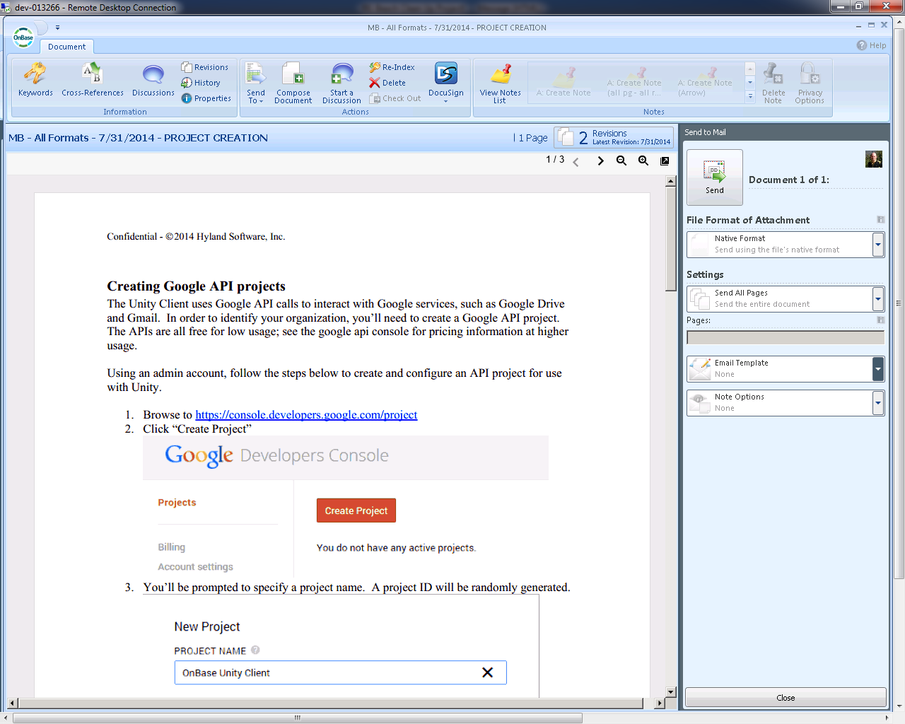
4. Send to Mail via Gmail
Send external mail message via Gmail
Notes:
Send to Mail via Gmail
Upload message as Draft to Gmail with document attached
Works with Email Template created in Configuration
Note, opened in Chrome
Doesn't work with UPop URL links, google strips it out...only works with Upop attachments and DocPop links

Slide 7
www.onbase.com/community
Notes:
Please post any questions to the Integration for Google Services Product Community.

